Slide 1
Web Exercise
for Backend Developers
AUTHOR: Florin Dascalu
LJUNGBY: 2020 December

Slide 2
Agenda
1. Login
Identity seed code
Sign In
2. CRUD operations for company / store
Create / Display / Edit / Delete companies
Create (include geocoding) / Display / Edit / Delete stores
3. Google Maps
Display coordinates - Geocoding
Display address – Reverse Geocoding
4. Database
Script for creating DataBase
Seed for seeding data in tables

Slide 3
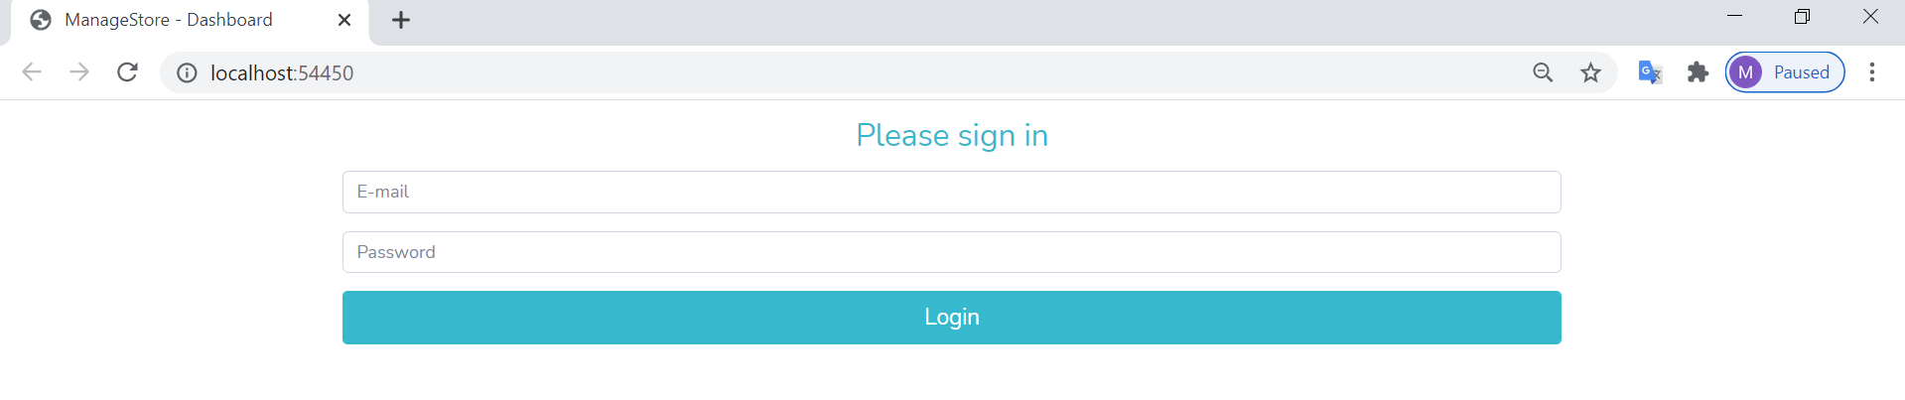
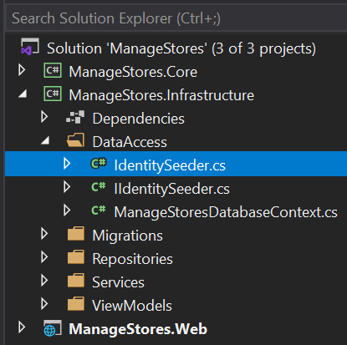
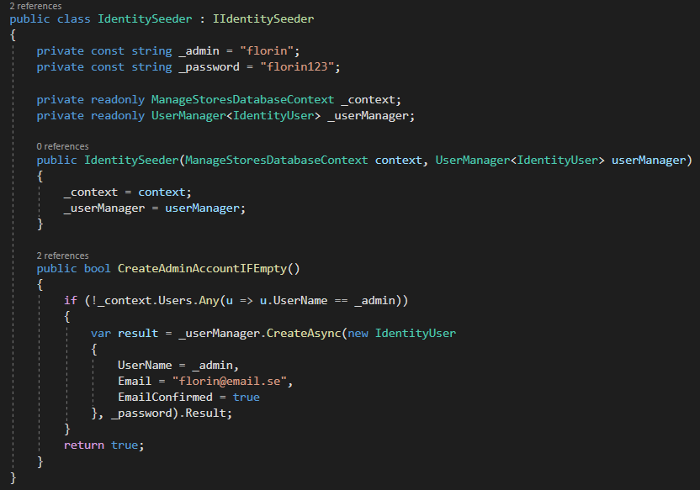
Login
Identity Seed code

Slide 4
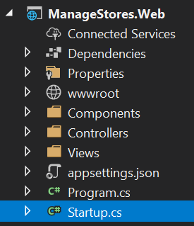
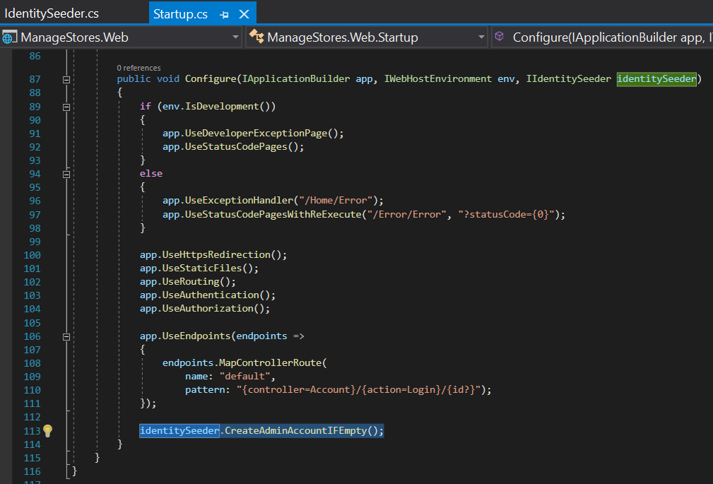
Login
Identity Seed code

Slide 5
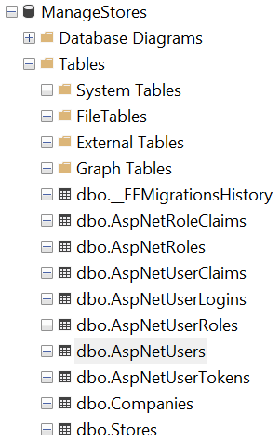
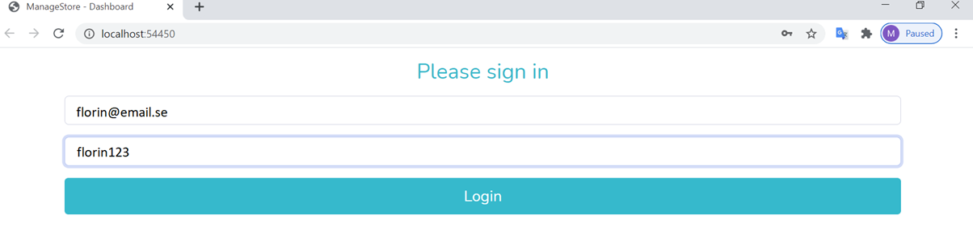
Login
Sign in
Next step

Slide 6
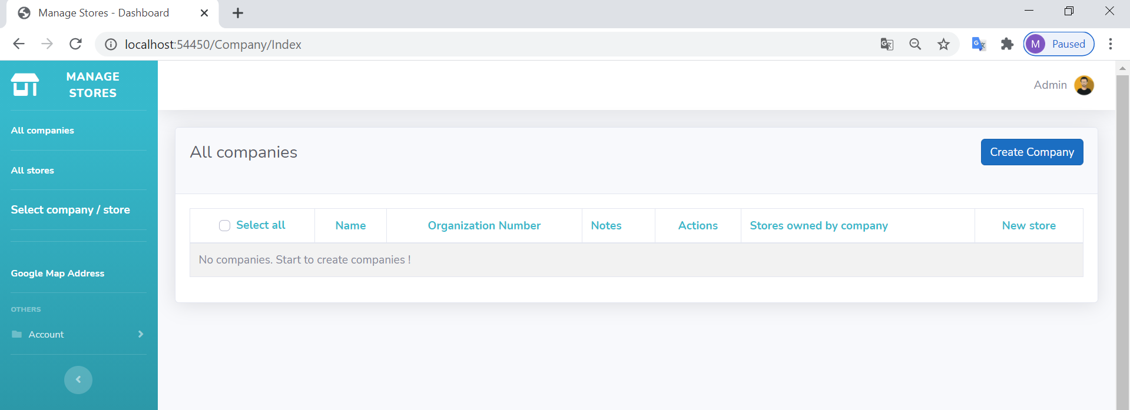
Start page / Company/Index
Create a new Company
Next step

Slide 7
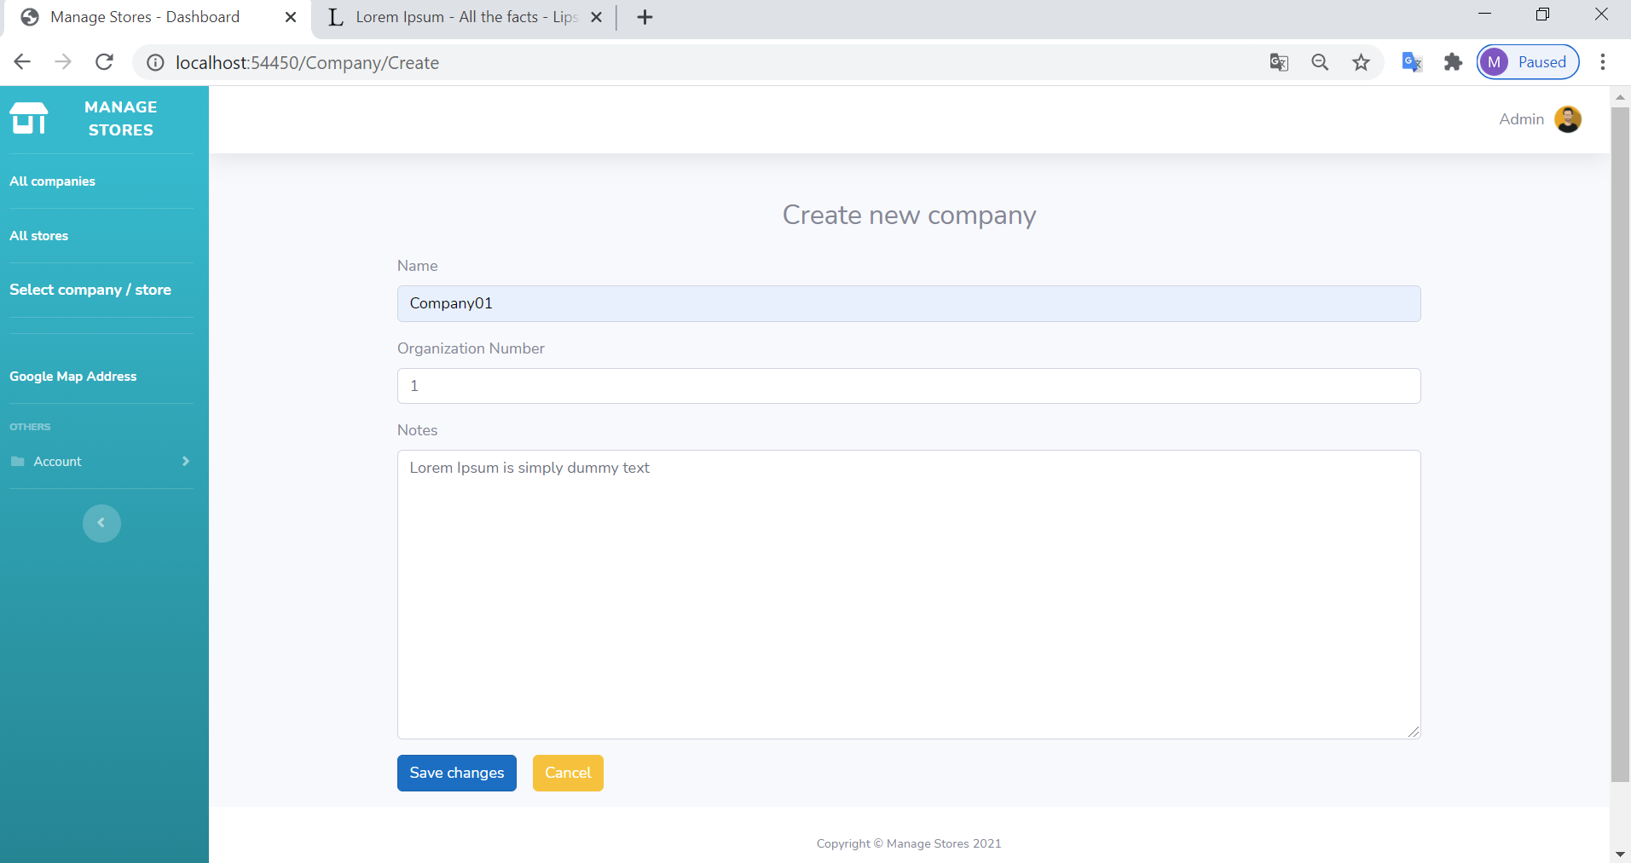
Create a new company page
Save
Next step

Slide 8
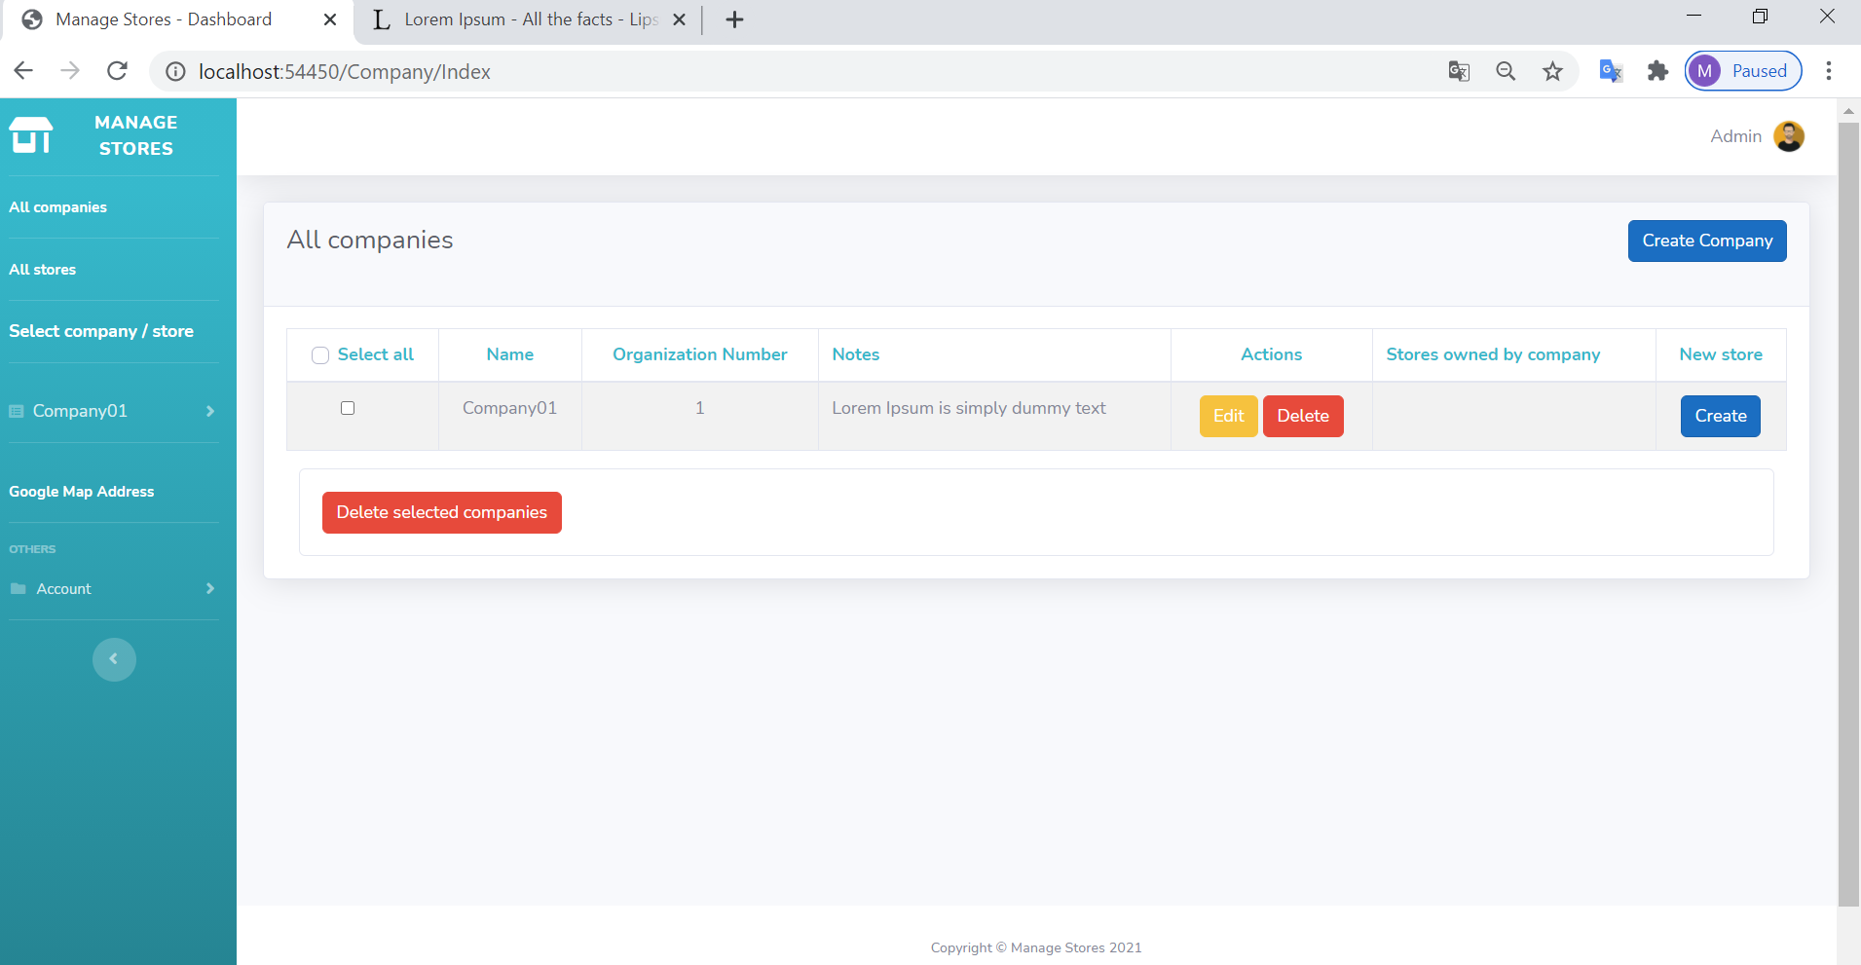
Display Companies
Create others companies
Next step

Slide 9
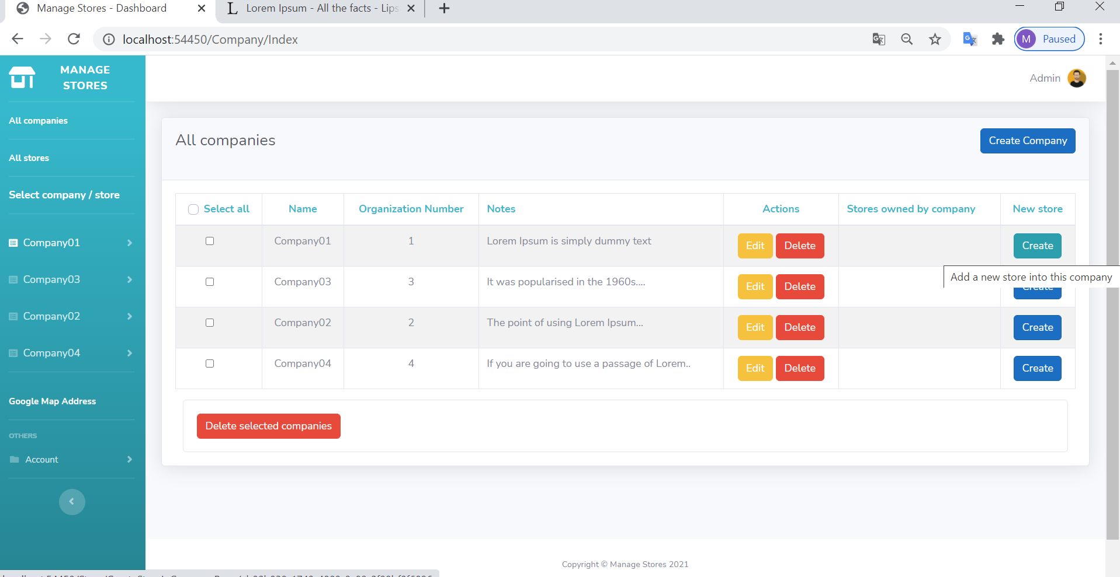
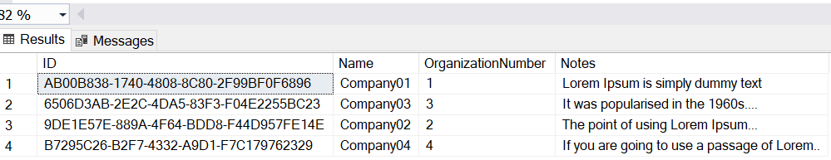
Display all Companies
Create a store in Company01
Next step

Slide 10
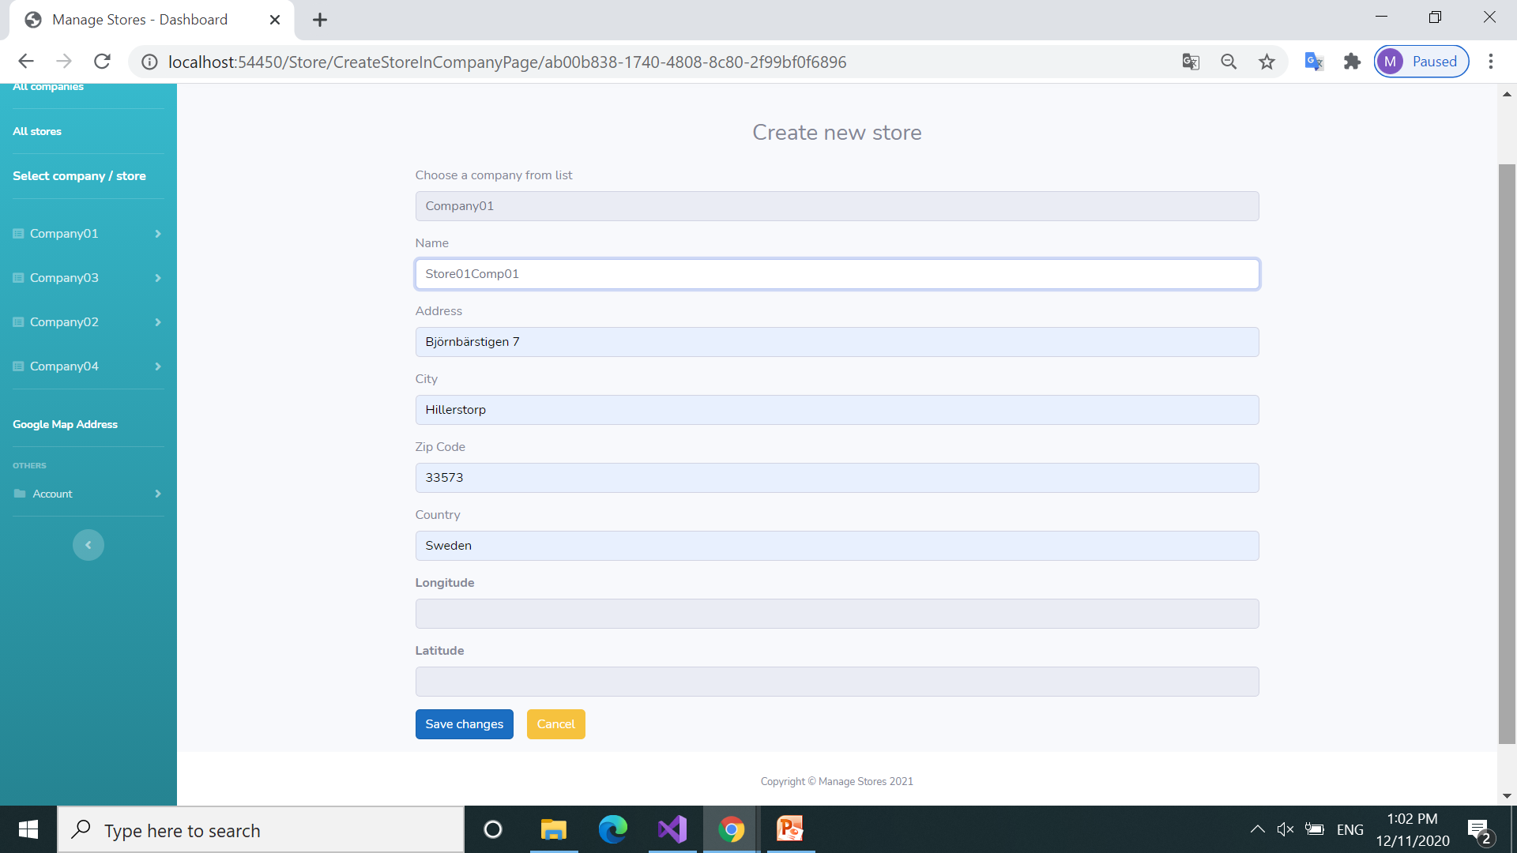
Create a new store for Company01
The coordinates will not be filled in
The coordinates will be automatically retrieved from the Google App
Next step

Slide 11
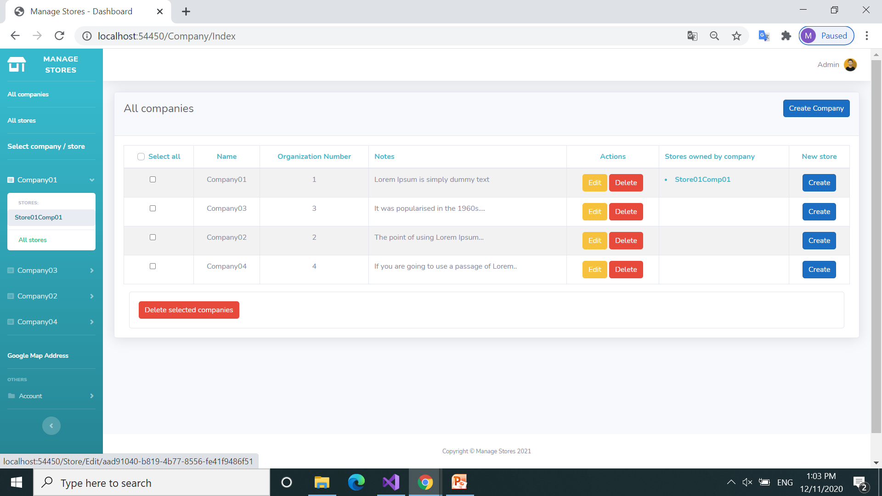
Display all Companies
Company01 includes a new store: “Store01Comp01”

Slide 12
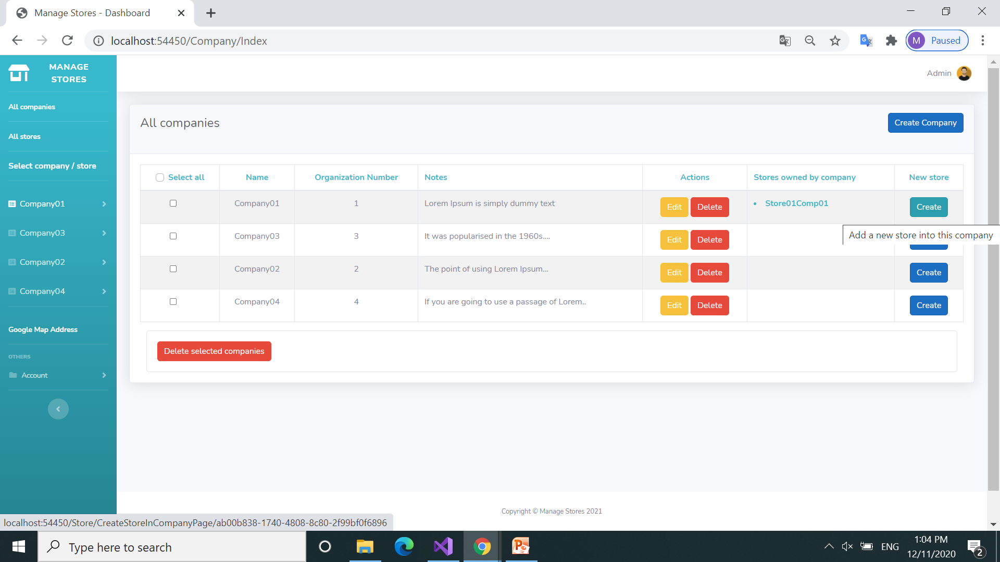
Display all Companies
Create a new store in Company01
Next step

Slide 13
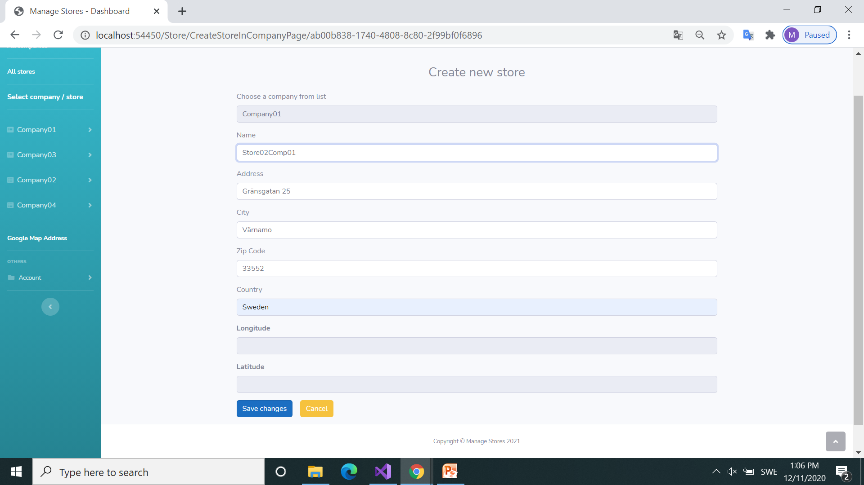
Create another store in Company01
The coordinates will not be filled in
The coordinates will be automatically retrieved from the Google App
Next step

Slide 14
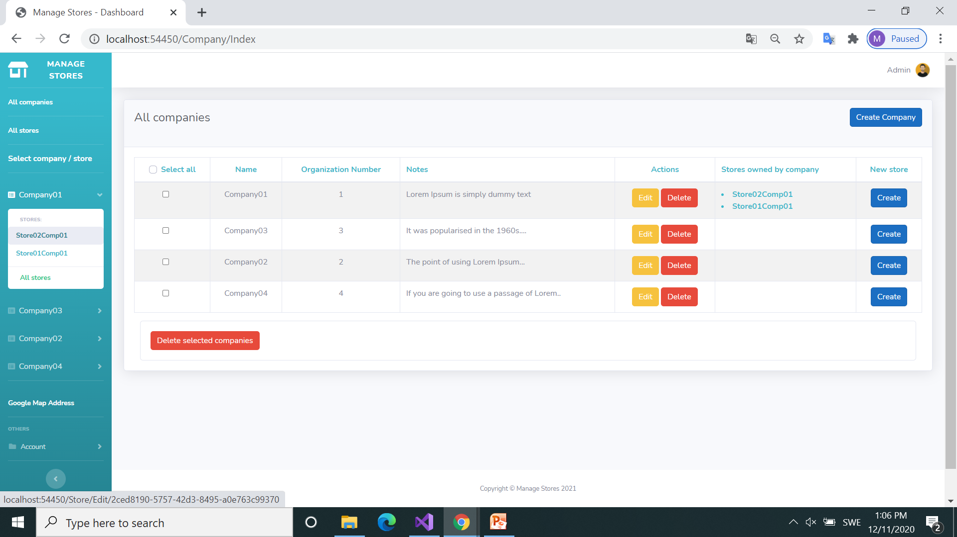
Display all Companies
Click to display all stores
Next step

Slide 15
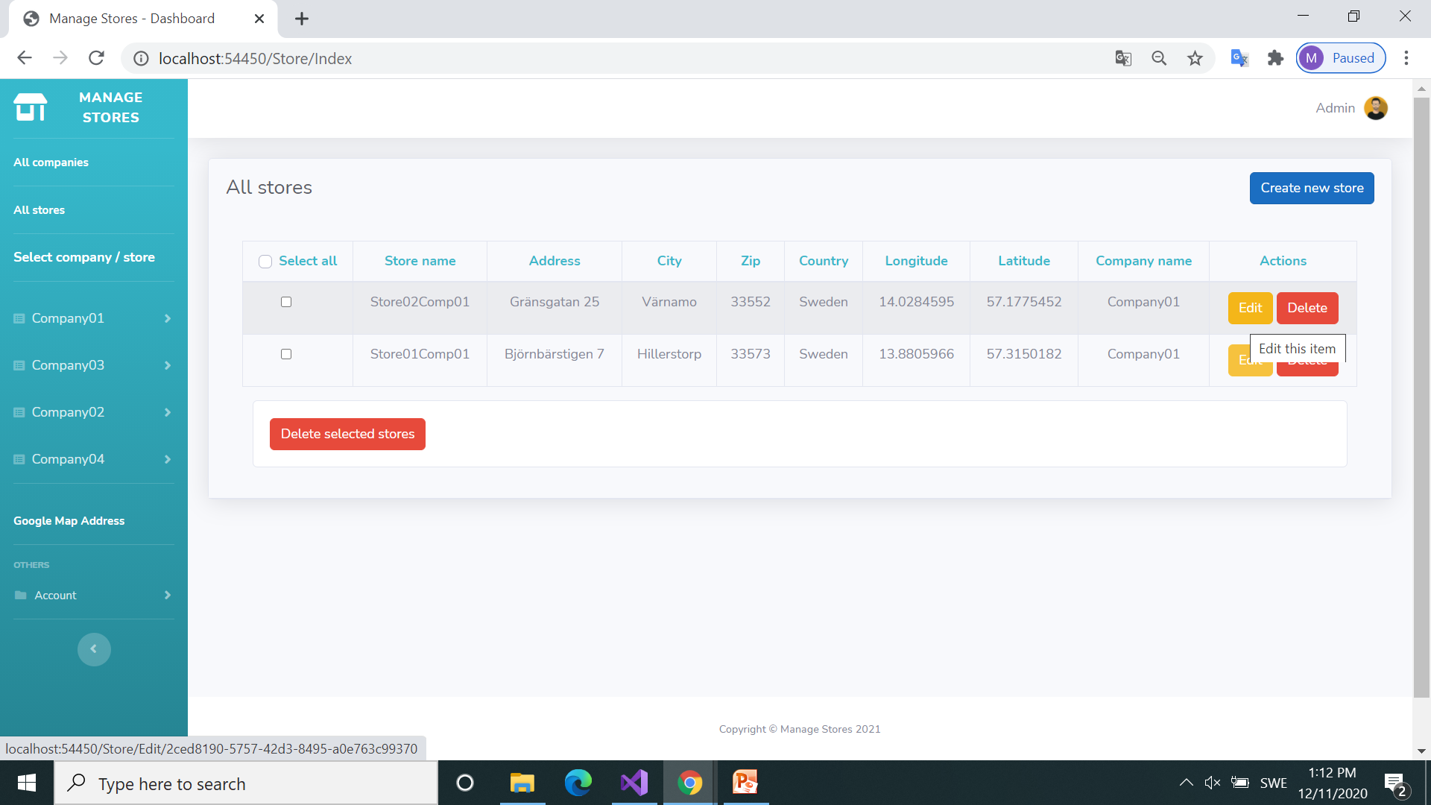
Display all Stores
Stores now contain coordinates retrieved from the Google Maps app

Slide 16
Display all Stores
Edit store: “Store02Comp01”
Next step

Slide 17
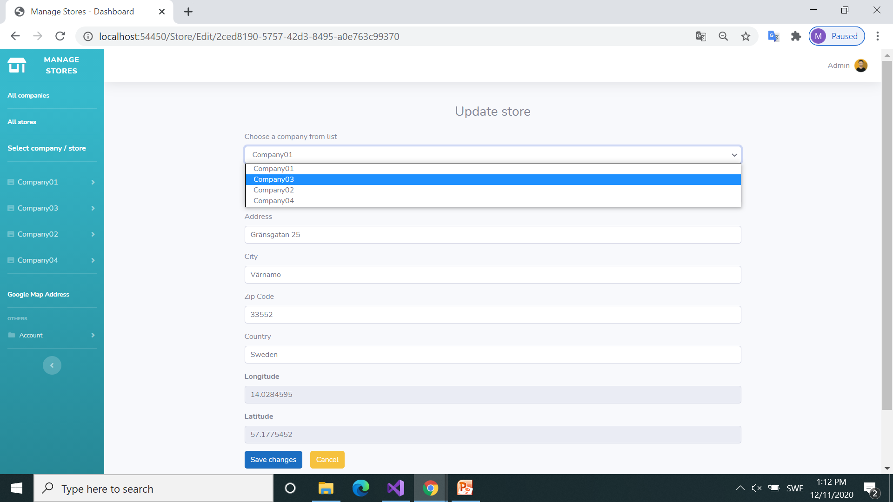
Update store “Store02Comp01”
Change company to Company03
Next step
These information are not editable

Slide 18
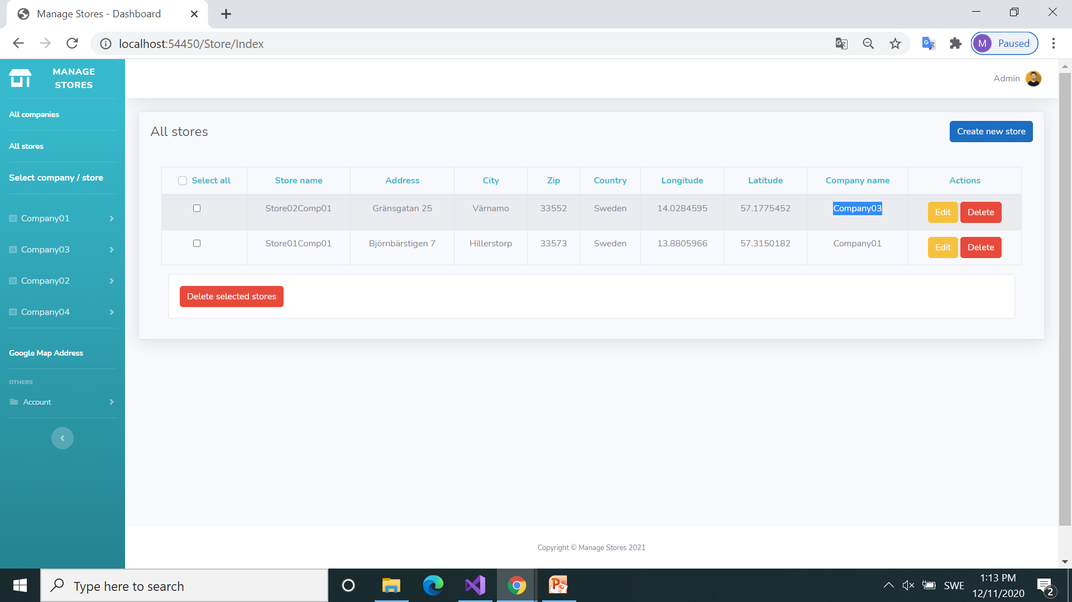
Display all Stores
Store02Comp01 is part of Company03
Next step

Slide 19
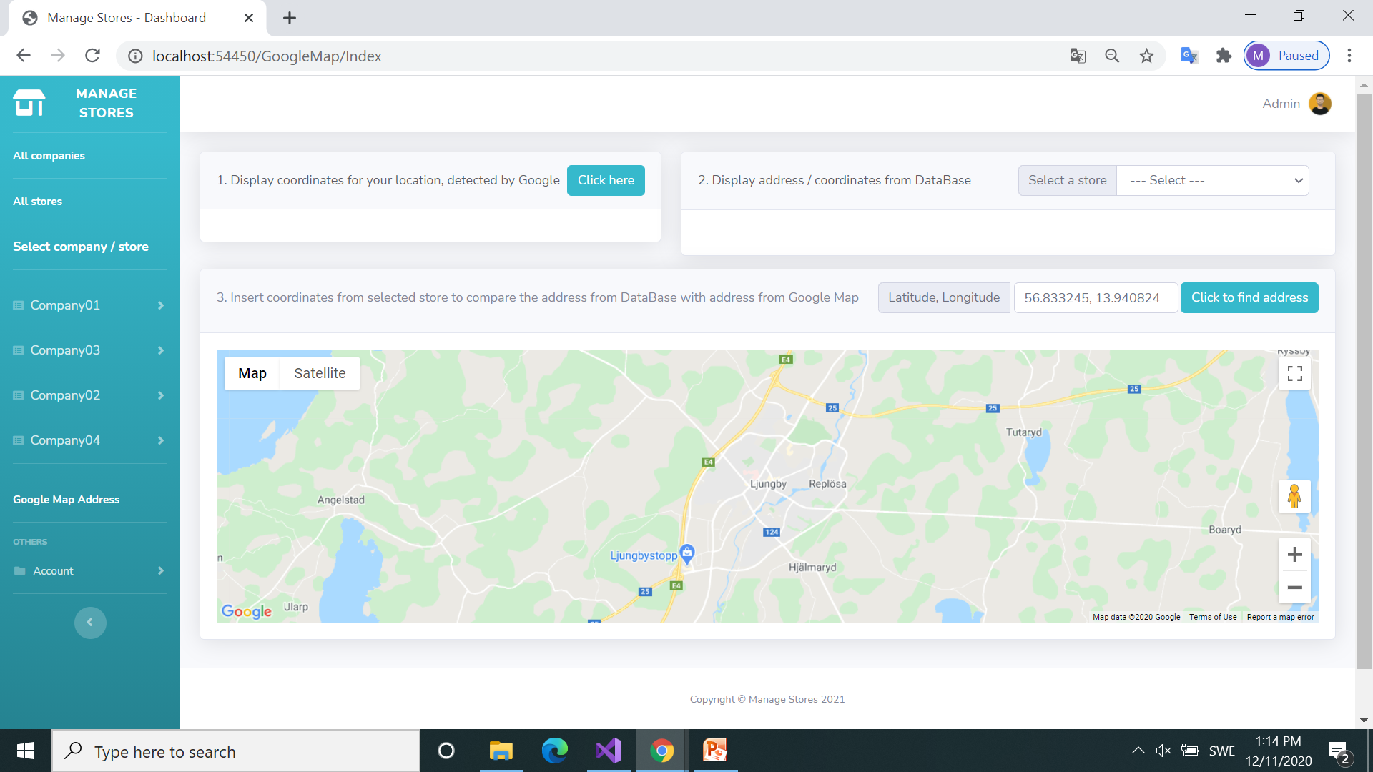
Google Maps
Display coordinates from your location (according to internet provider)
Next step

Slide 20
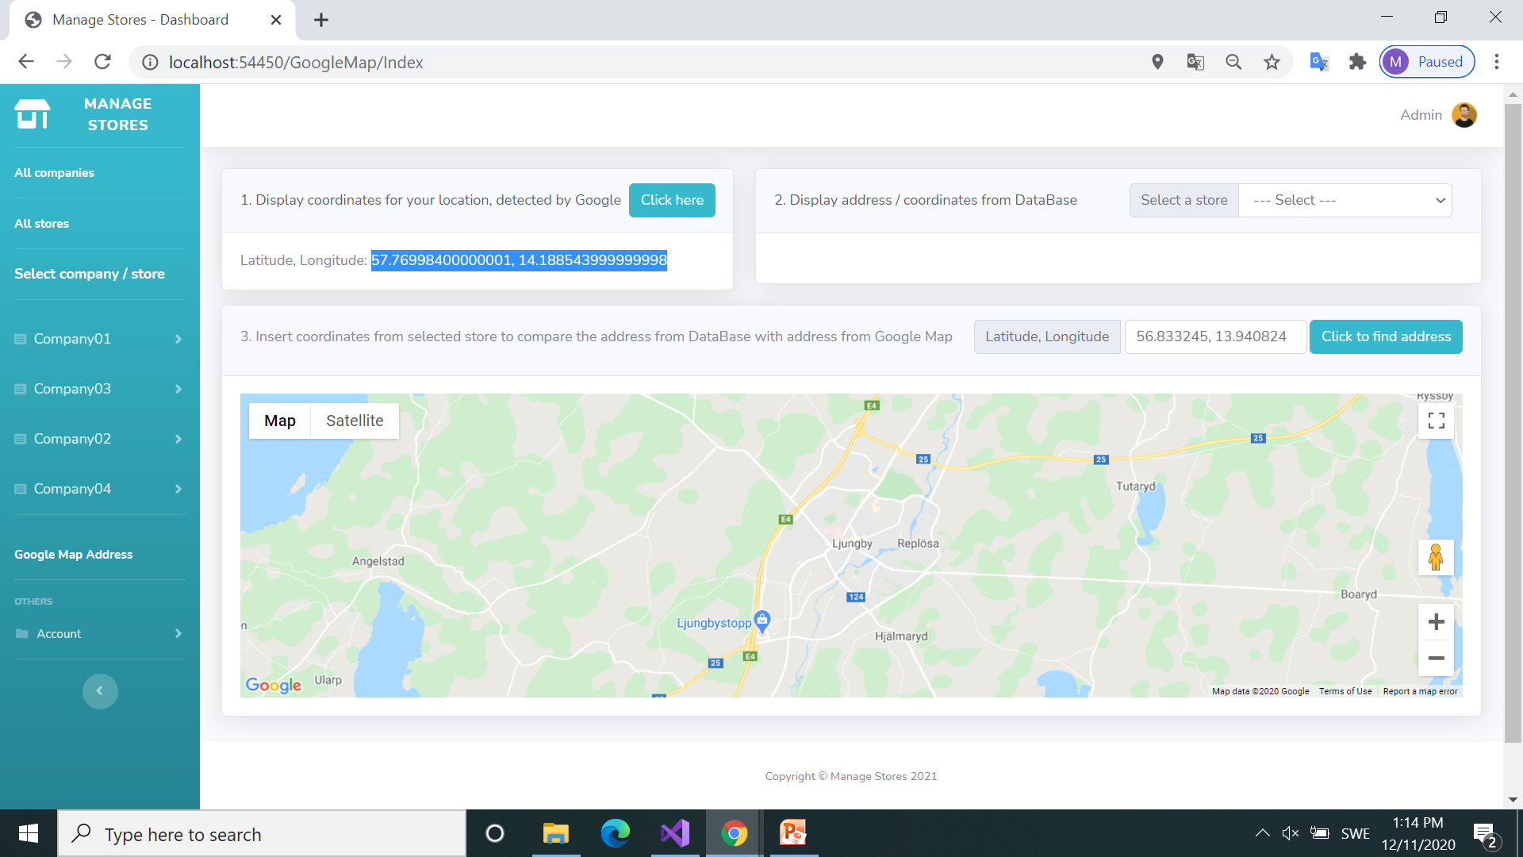
Google Maps
Coordinates from your location are now displayed
Display results

Slide 21

Google Maps
Copy / paste coordinates to display location on Google Maps
Copy coordinates here
Next step

Slide 22
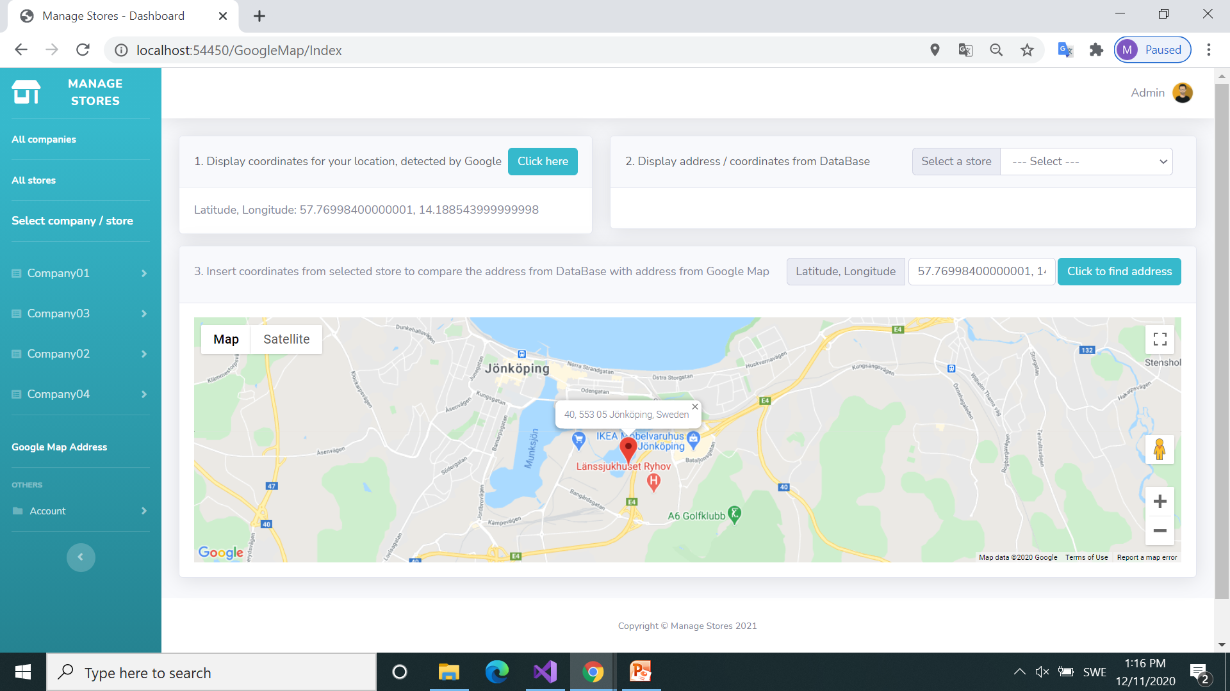
Google Maps
The address is displayed on Google maps
Display results

Slide 23
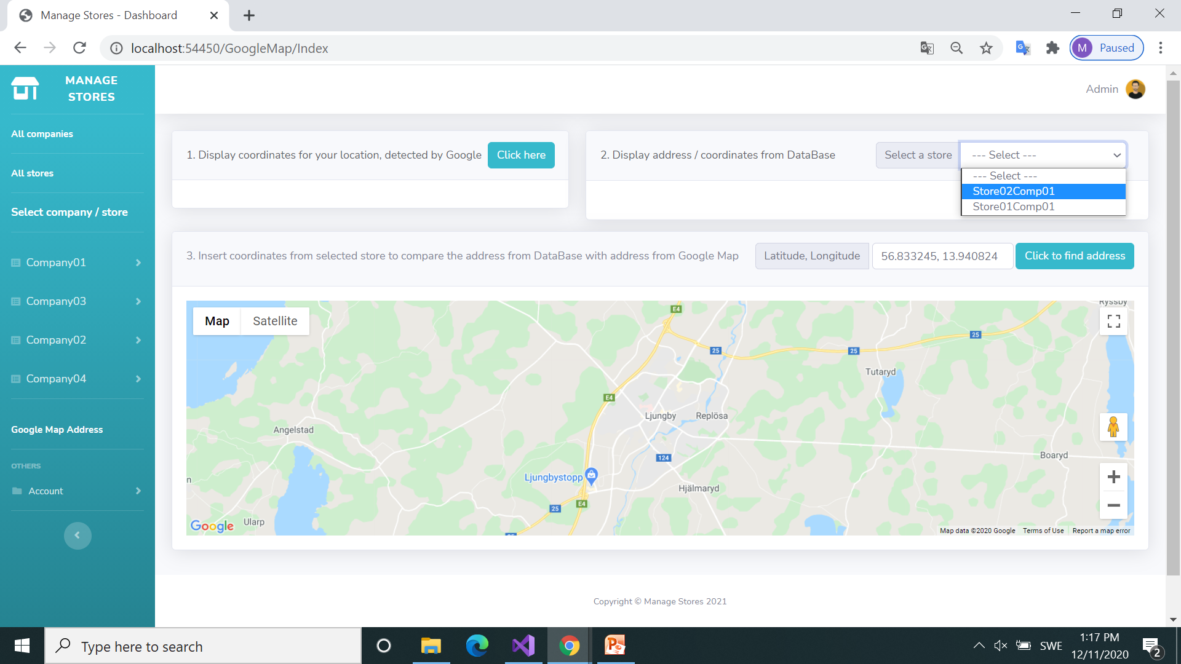
Google Maps
Select a store from database: “Store02Comp01”
Next step

Slide 24
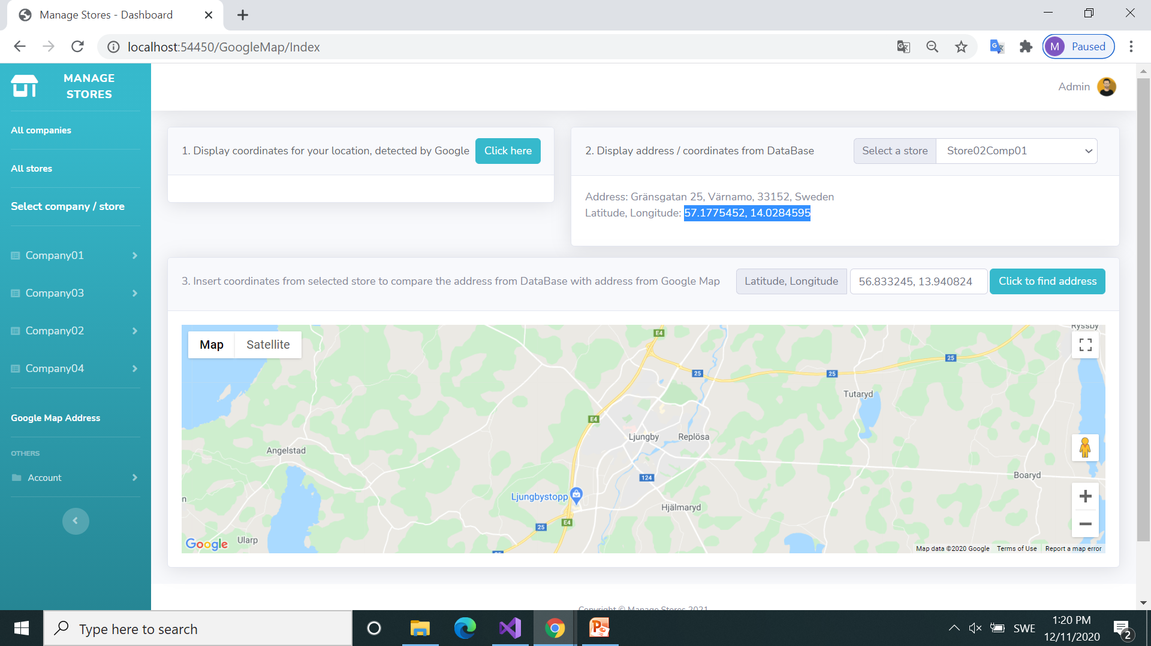
Google Maps
Retrieve data from DataBase: Address & Coordinates
Display results

Slide 25
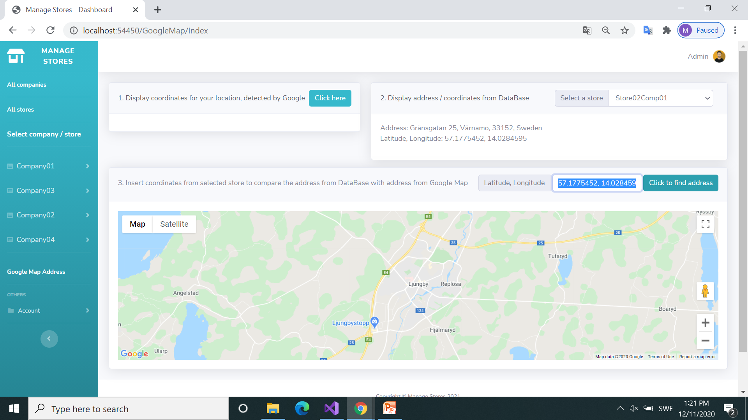
Google Maps
Copy / paste coordinates to display location on Google Maps
Copy coordinates here
Next step

Slide 26
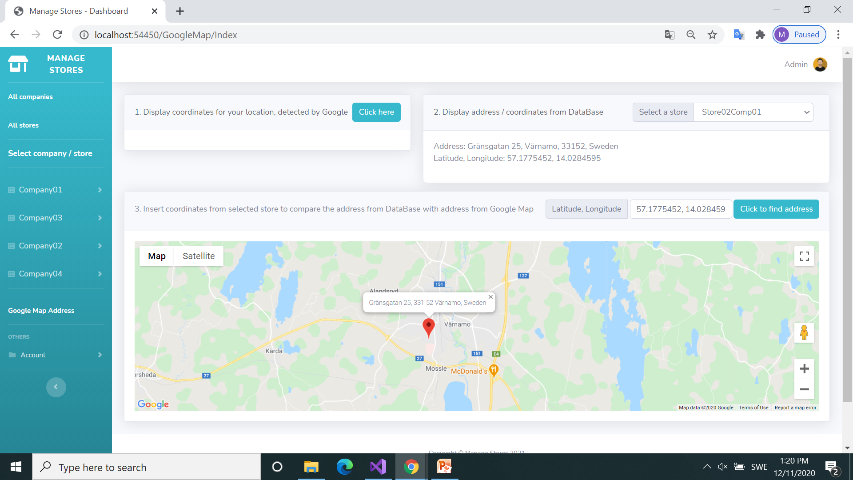
Google Maps
Compare address from Database with address from Google Maps
Address from DataBase is now confirmed by Google Maps
Display results

Slide 27
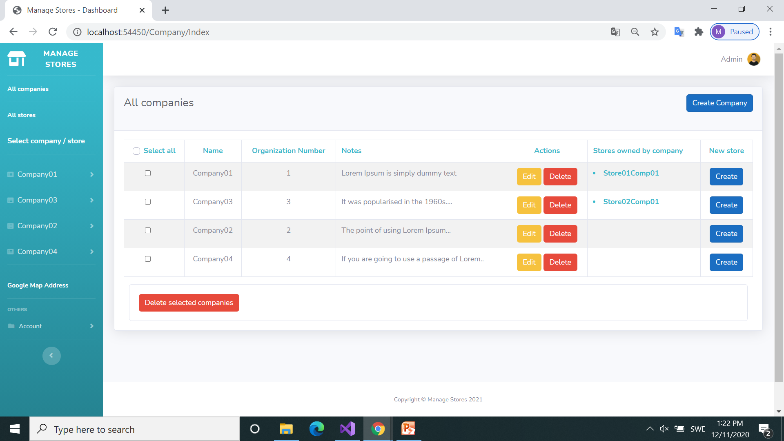
Display all Companies
Edit Company04
Next step

Slide 28
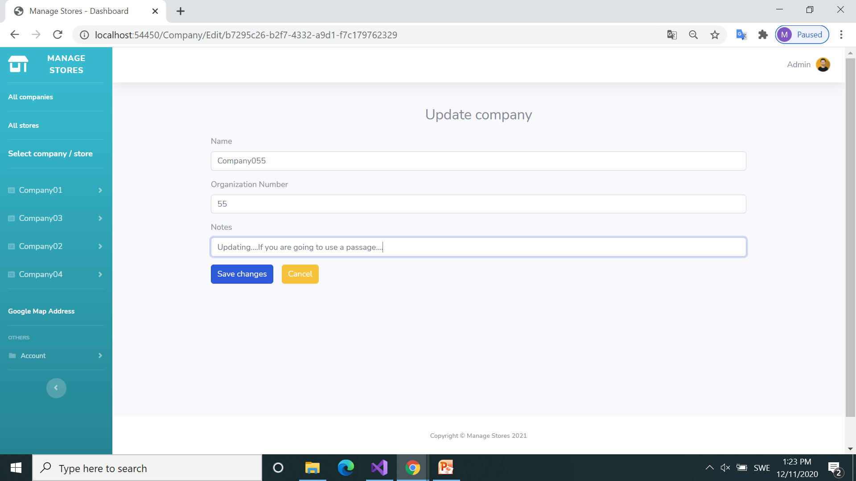
Update company
Change data and save
Next step

Slide 29
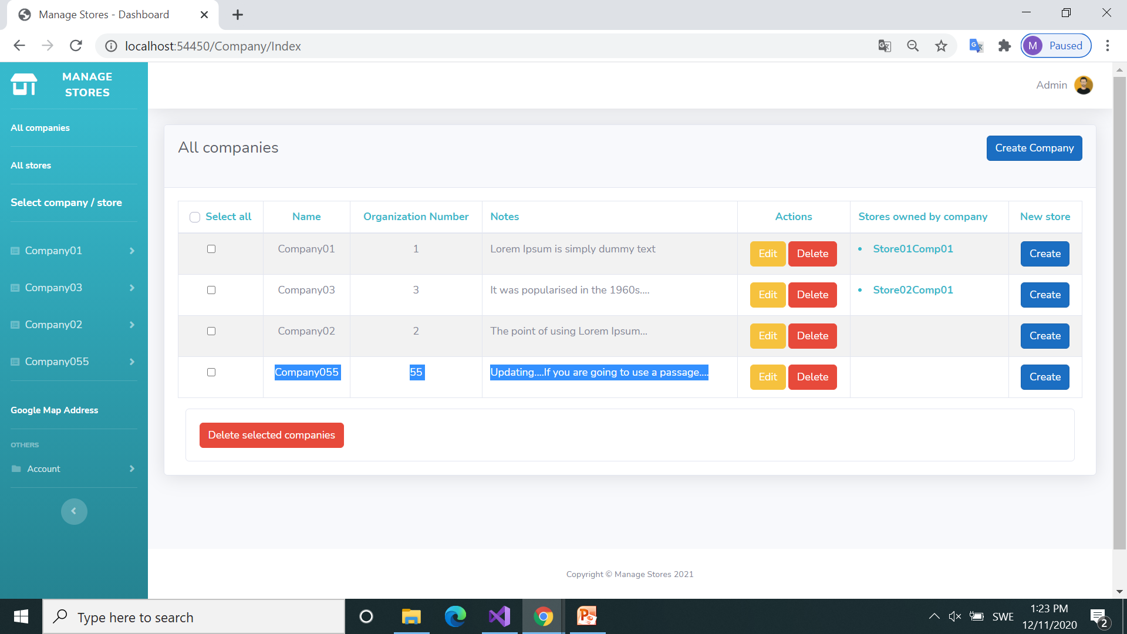
Display all Companies
Delete the updated Company055
Company updated
Next step

Slide 30
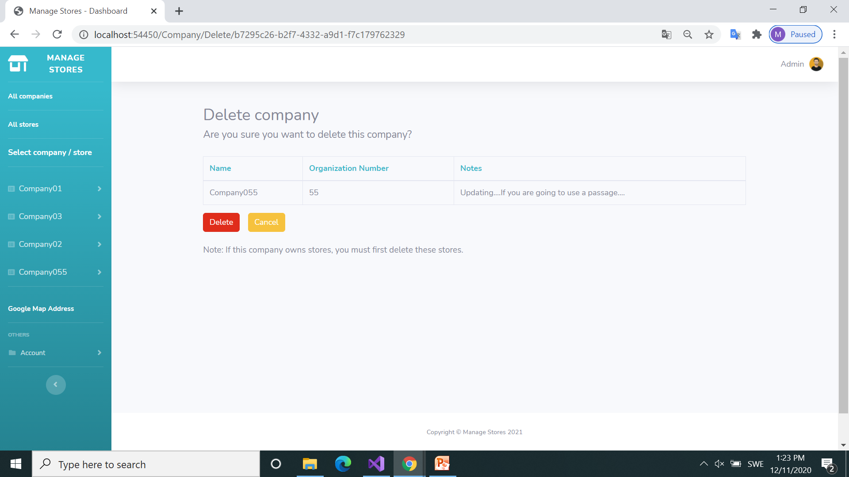
Display Company055
Confirm delete
Next step

Slide 31
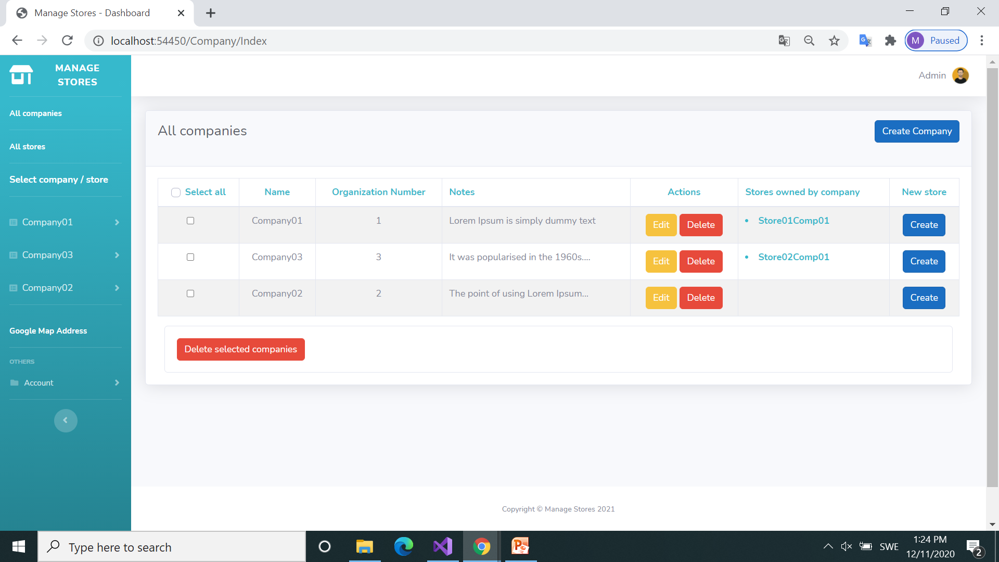
Display all Companies
Click to display all stores
Next step
Company055 deleted

Slide 32
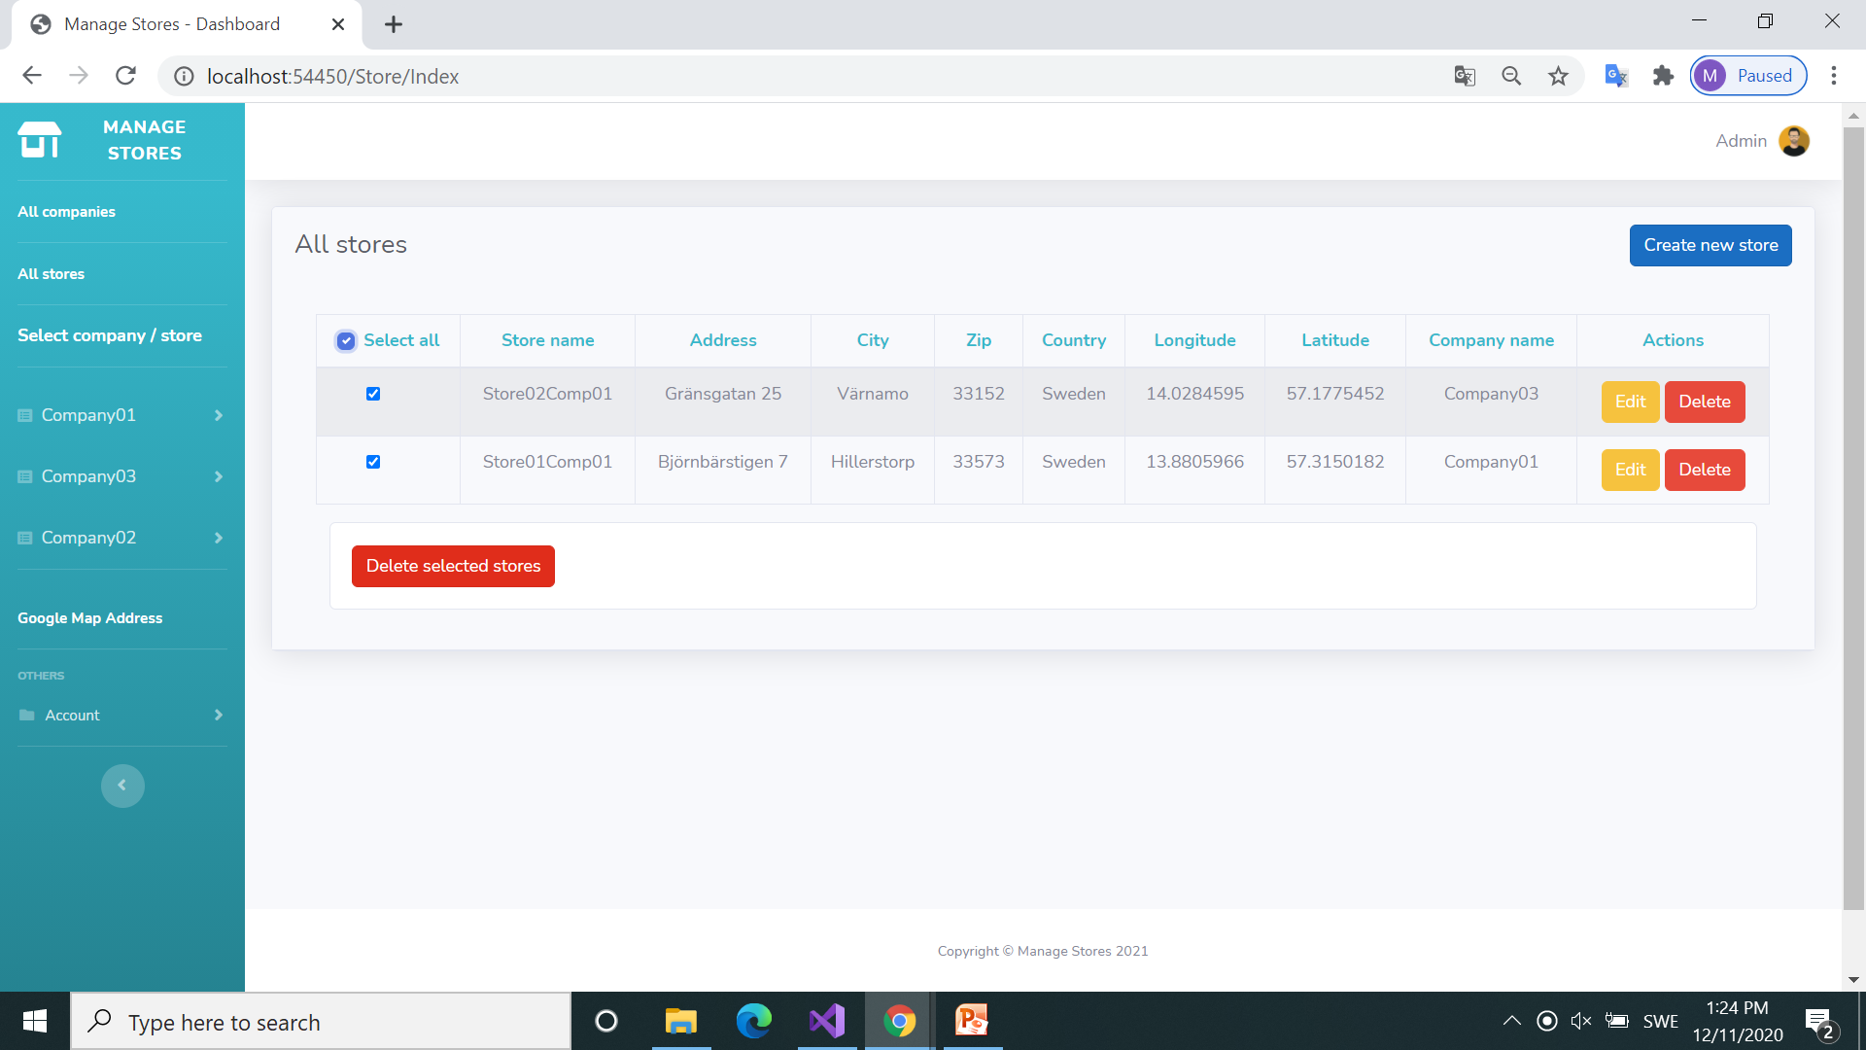
Display all stores
Select all stores and click delete
Next step

Slide 33
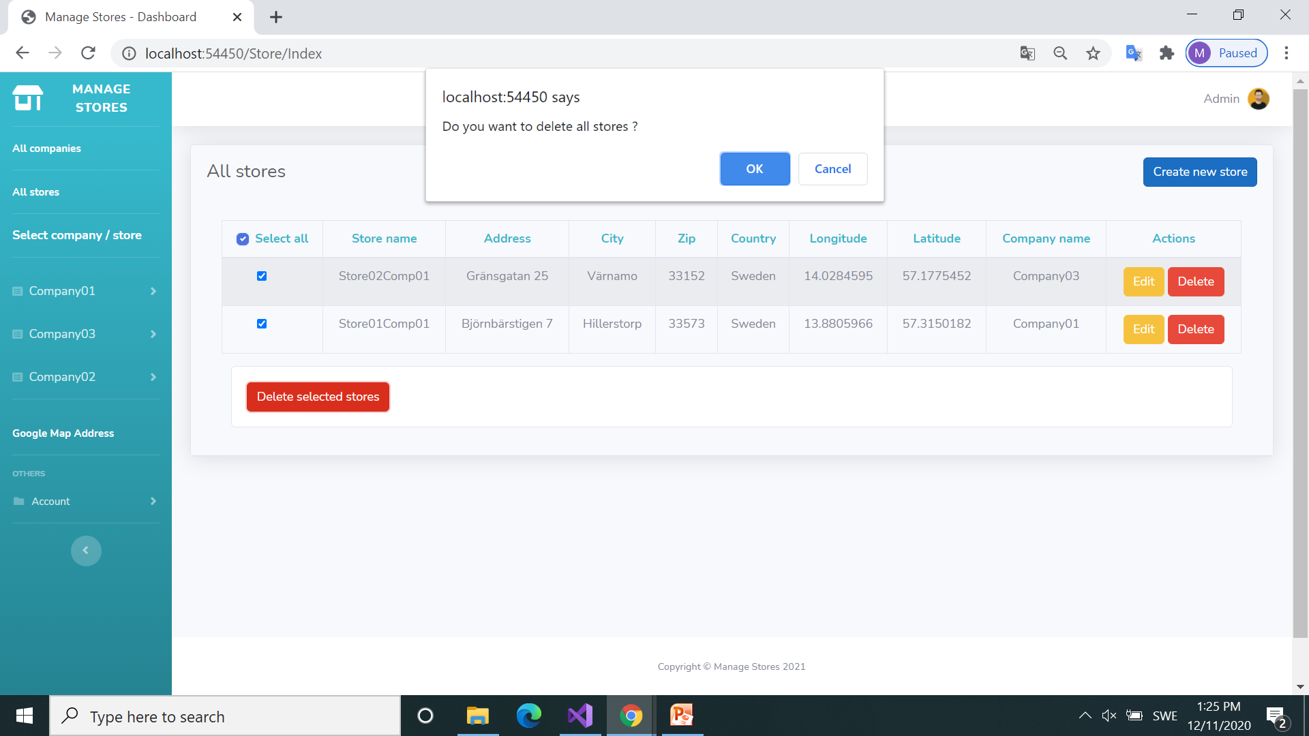
Display all stores
Confirm delete

Slide 34
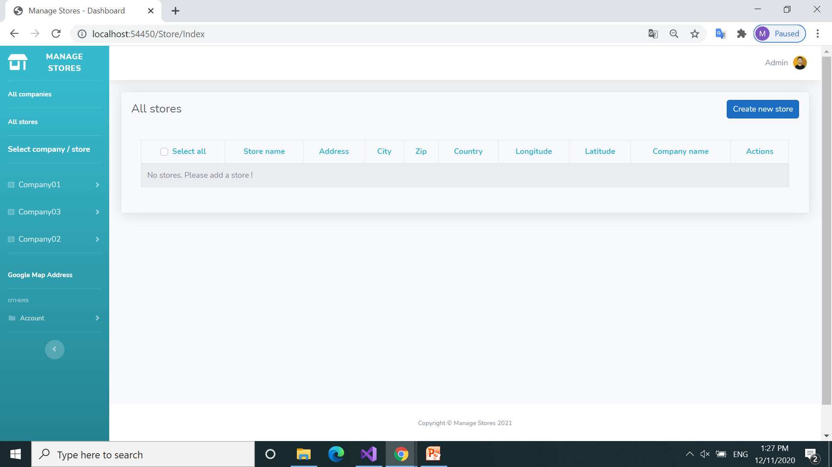
Display all stores
No stores
Next step

Slide 35
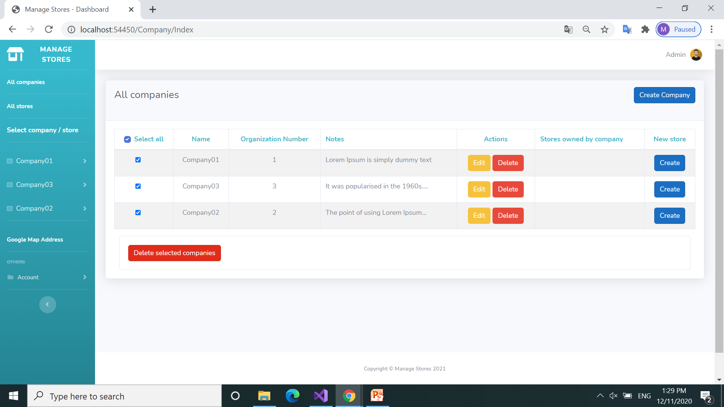
Display all companies
Select all companies and click delete
Next step

Slide 36
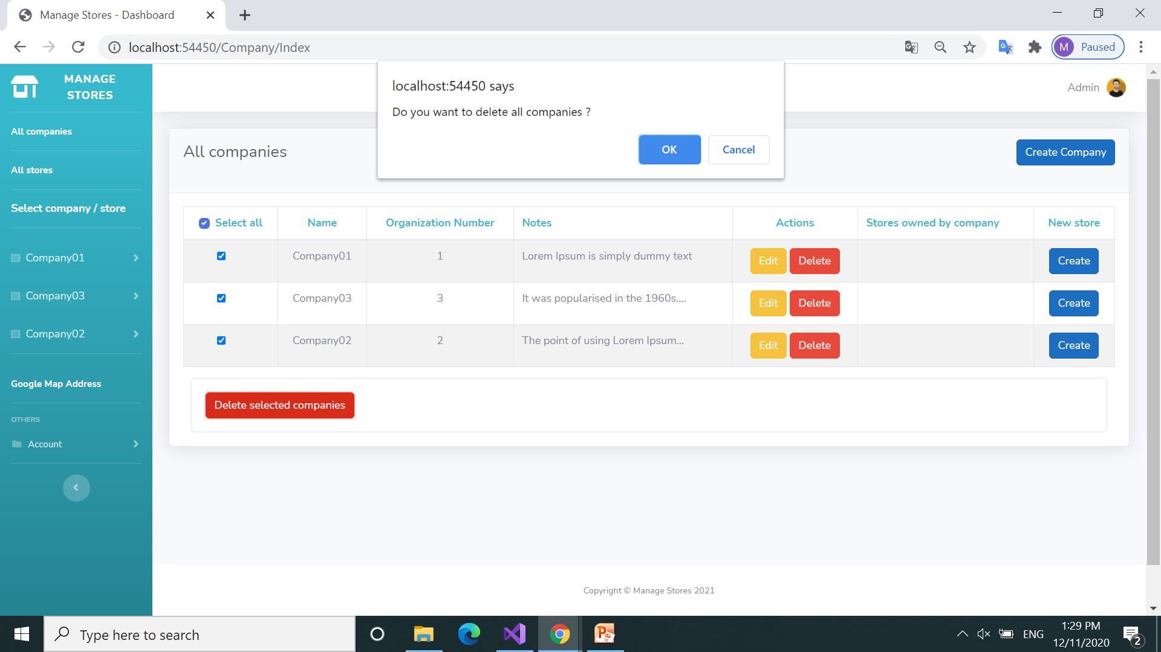
Display all companies
Confirm delete

Slide 37
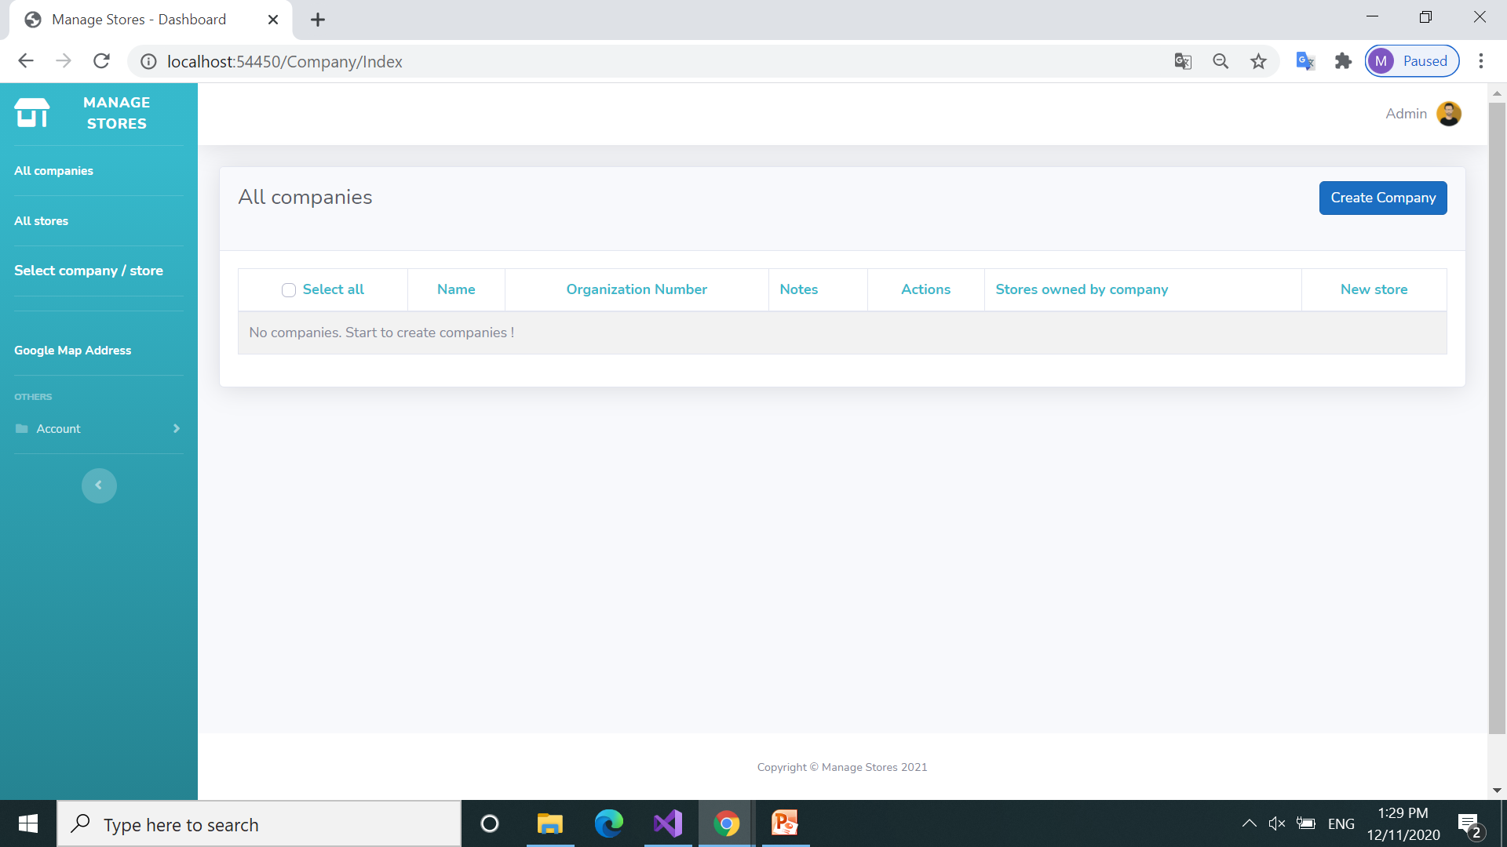
Display all companies
Click to Account to log out
Next step

Slide 38
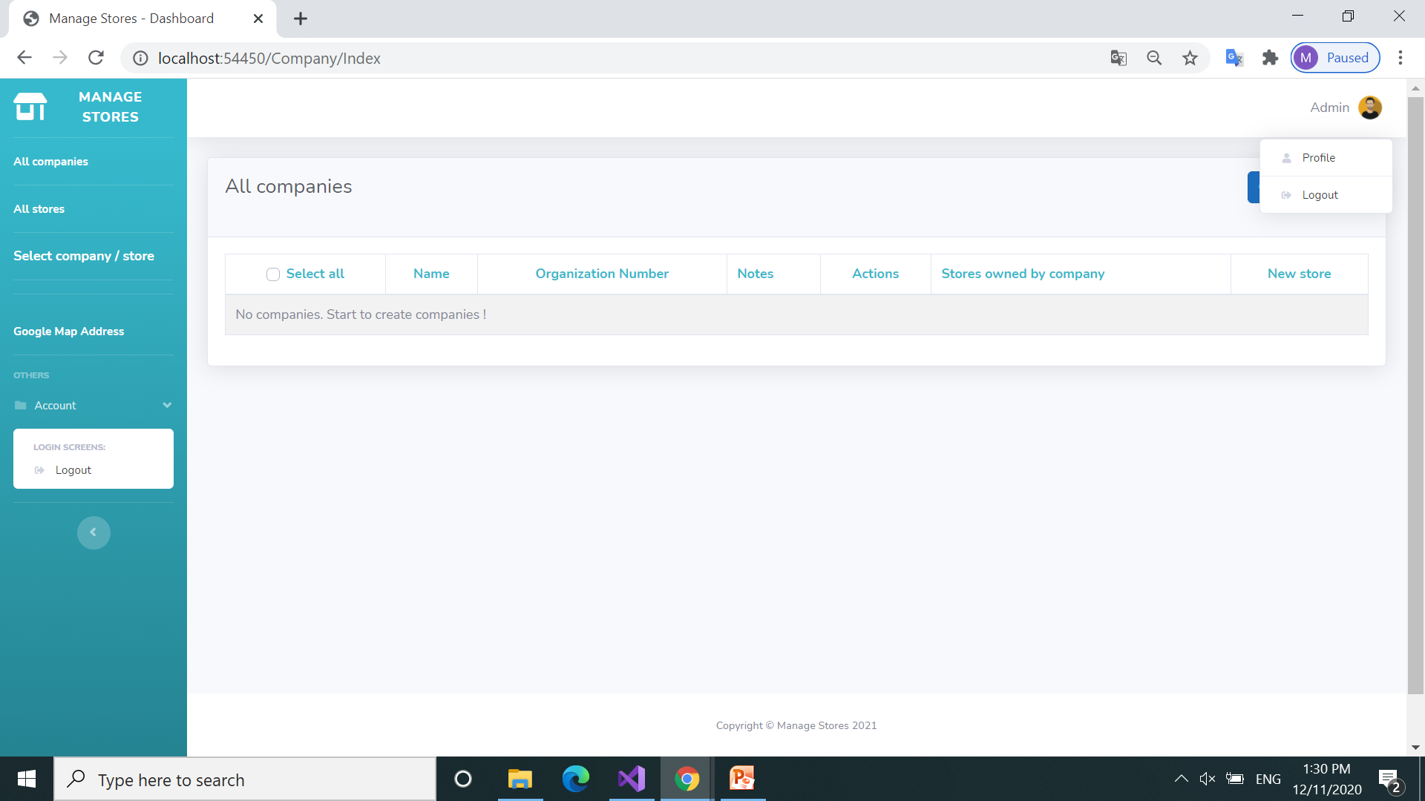
Display all companies
Click to Account to log out
Next step

Slide 39
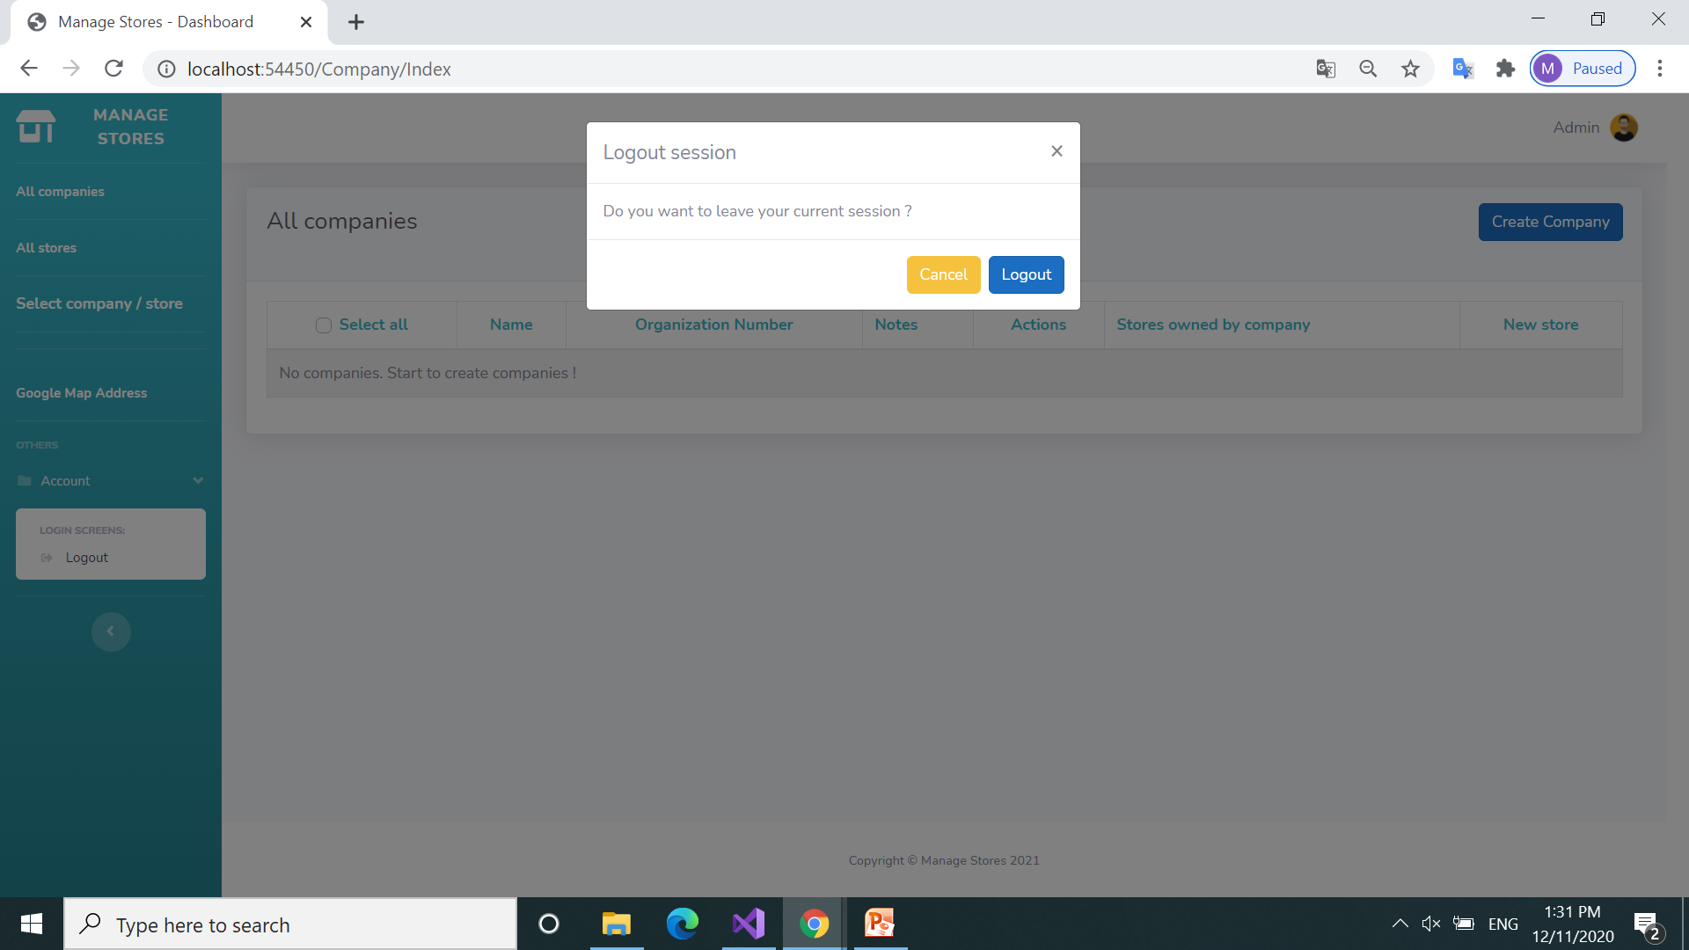
Logout modal
Confirm Log out
Next step

Slide 40
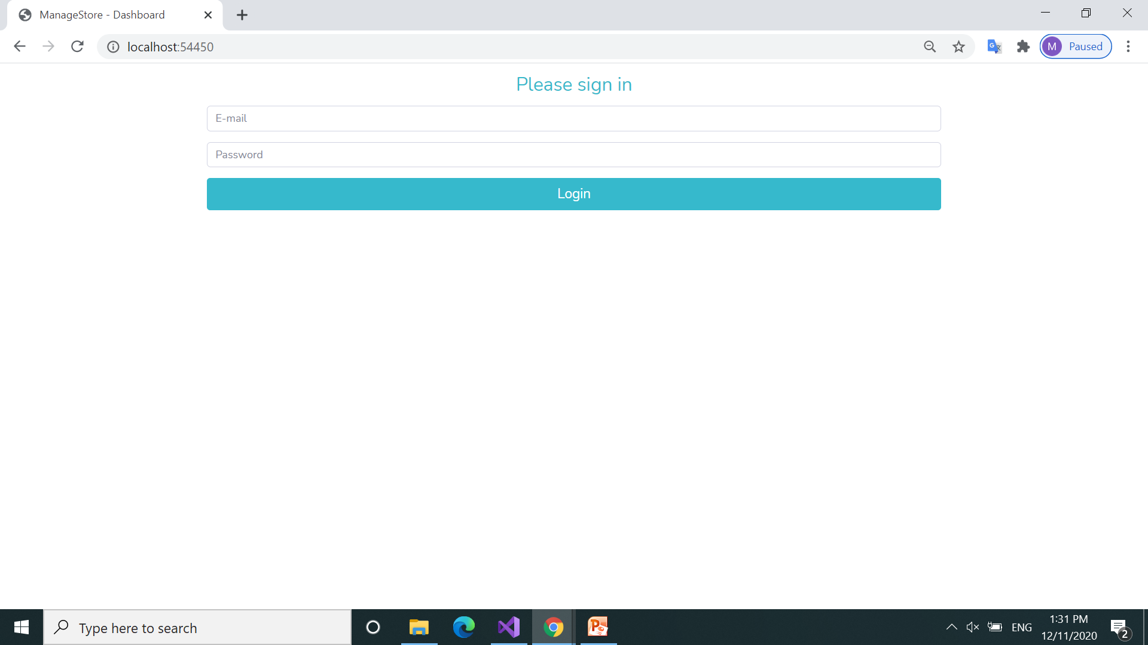
Start application page

Slide 41
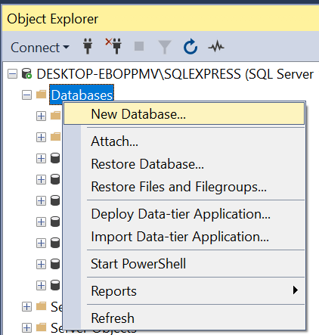
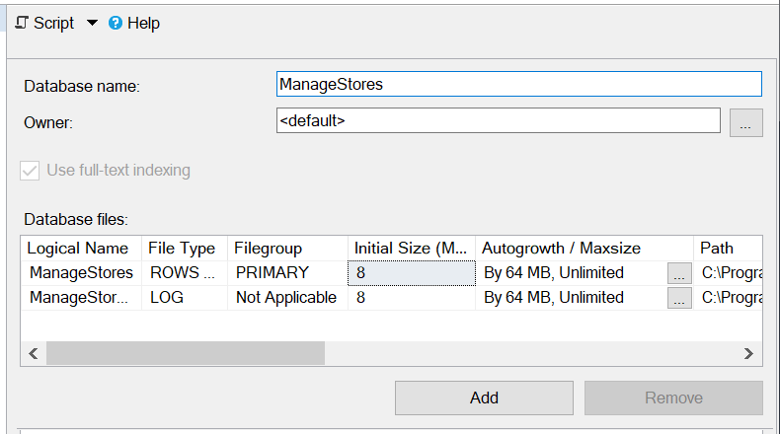
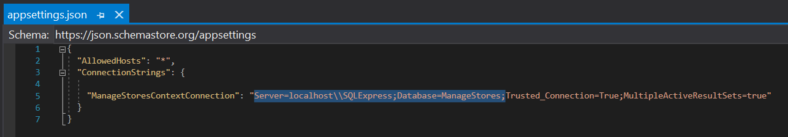
Creating the database
1. Create database first in Microsoft SQL Server App: “ManageStores”

Slide 42
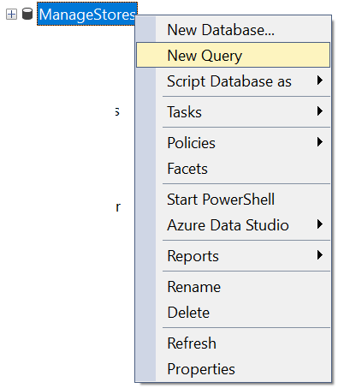
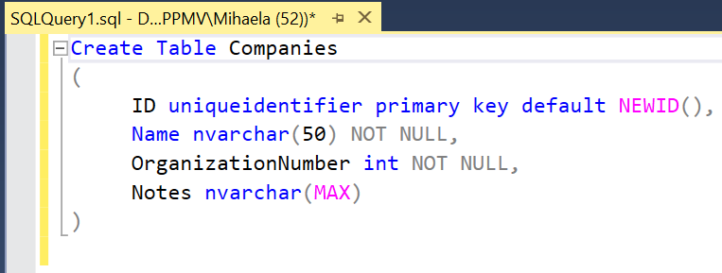
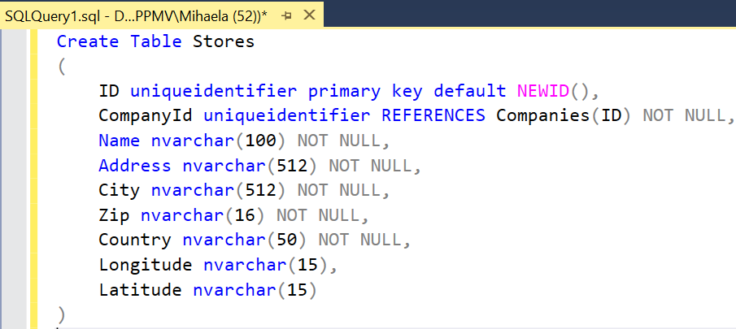
Scripts for creating these 2 tables in database. Use New Query

Slide 43
Scripts for creating these 2 tables in database
Create Table Companies
(
ID uniqueidentifier primary key default NEWID(),
Name nvarchar(50) NOT NULL,
OrganizationNumber int NOT NULL,
Notes nvarchar(MAX)
)
Create Table Stores
(
ID uniqueidentifier primary key default NEWID(),
CompanyId uniqueidentifier REFERENCES Companies(ID) NOT NULL,
Name nvarchar(100) NOT NULL,
Address nvarchar(512) NOT NULL,
City nvarchar(512) NOT NULL,
Zip nvarchar(16) NOT NULL,
Country nvarchar(50) NOT NULL,
Longitude nvarchar(15),
Latitude nvarchar(15)
)

Slide 44
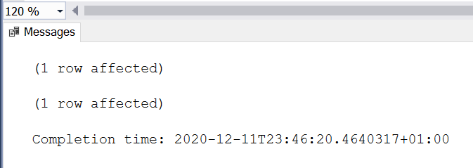
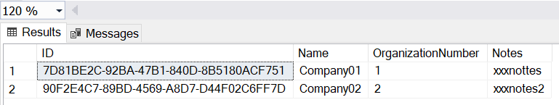
Scripts for seeding / populating Companies table in database.
Insert Into Companies Values (Default, 'Company01', 1, 'xxxnottes')
Insert Into Companies Values (Default, 'Company02', 2, 'xxxnotes2')

Slide 45
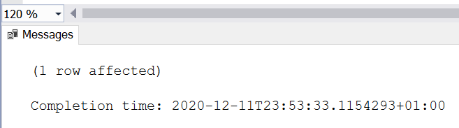

Scripts for seeding / populating Stores table in database (CompanyId)
INSERT INTO Stores VALUES
( Default,
(SELECT ID from Companies WHERE ID='7D81BE2C-92BA-47B1-840D-8B5180ACF751'),
'Store02Comp01', 'Gränsgatan 25', 'Värnamo', '33152', 'Sweden',
Default, Default
)
Observation: Longitude and Latitude are NULL for the moment

Slide 46

Click to store “Store02Comp01” to update Google Coordinates
Next step

Slide 47

Update store
The coordinates will be automatically retrieved from the Google App
Next step

Slide 48

Coordinates are now updated in store: “Store02Comp01”

Slide 49
Coordinates are now updated in store: “Store02Comp01”

Slide 50
Tack !

